Slide 1
The effects of 5-HT regulation on BNST-related anxiety
Brock Baade

Slide 2
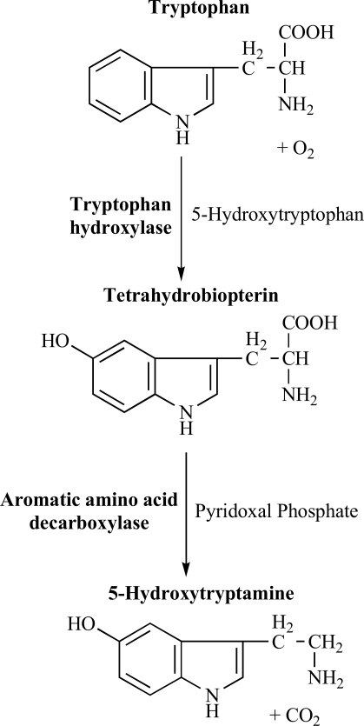
Serotonin
5-hydroxytryptophan (5-HT)
Discovered in 1912 (possibly 1868)^{1,2}
  “Enteramine”
Used throughout body³
  CNS
  GI tract
  Bone metabolism
Notes:
-Discovered initially as vasoconstrictor in GI tract
-1868 Germans saw that some serum in blood caused increased muscle tone
-O’Connor in 1912 discovers 5-HT (adrenaline-like substance) but doesn’t isolate
-initially called “enteramine” due to presence in gut mucosal cells→ until 50’s
-1953/4: Twarog & Page find 5-ht in brain of dog, rat, & rabbit
-5-HT receptors discovered in late 50’s & 60’s

Slide 3
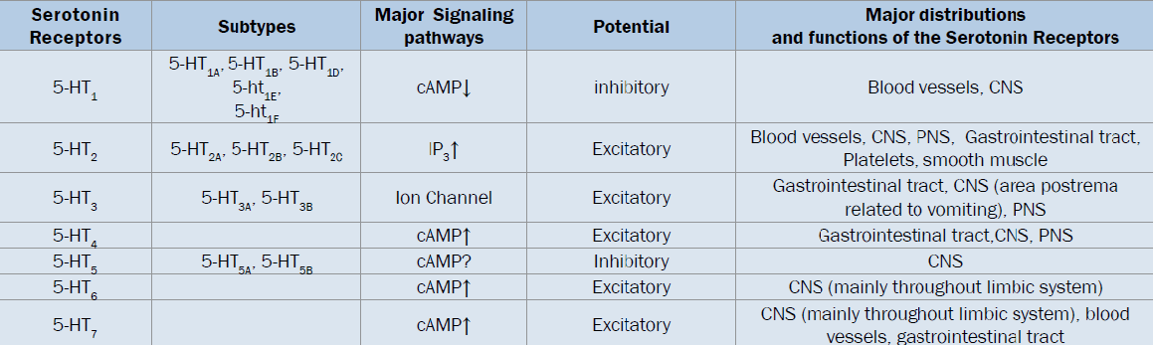
5-HT receptors^{3,4,5}
7 known “families”
  5-HT₁₋₇
14 known subtypes
  Involved in a variety of processes
  5-HT_{1E} function unknown
Notes:
-some cause nausea
-Mood, anxiety, vasomodulation, learning, reward, GI motility, etc.
-5 HT5B not found in humans (doesn’t code for protein)
-5-HT1E may be related to memory

Slide 4
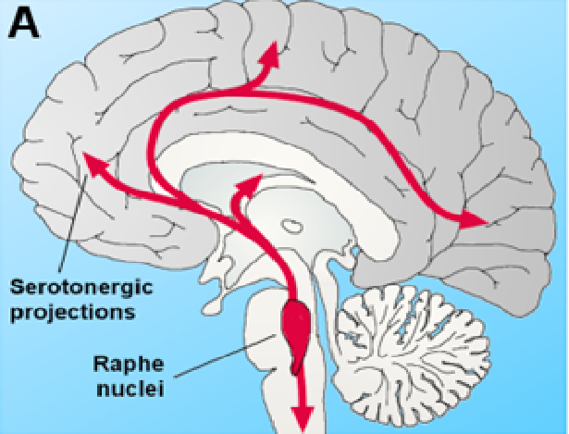
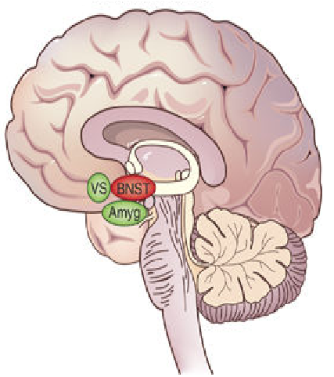
5-HT in the brain⁶
Raphe nuclei (RN) main source of 5-HT
  Cluster of nuclei in brainstem
Projections to brain and brain-stem
  BNST
RN 5-HT release regulated by several areas in the brain^{5,6}
Notes:
-dorsal raphe nuclei (DRN) primary 5-ht region
-dorsal raphe nucleus seems to be most regulated by other areas

Slide 5
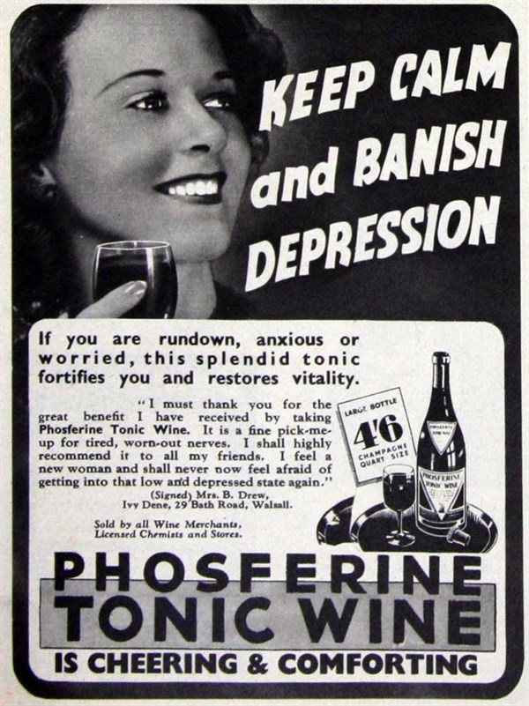
Why does this matter?
5-HT receptors targeted by medications^{3,6}
Anxiety & depression⁴
  SSRI’s
  Serotonin-norepinephrine reuptake inhibitors (SNRIs)
  Tricyclic antidepressants (TCAs)
  Monoamine oxidase inhibitors (MAOIs)
Notes:
-almost** every 5-ht receptor is targeted by some medication & linked to some problem if abnormal
-linked to disorders from migraines to IBS

Slide 6
BNST & 5-HT
Anxiety activates 5-HT neurons RN→BNST⁸
5-HT receptors differentially expressed throughout BNST^{2,3}
  Excitatory & inhibitory⁹
  5-HT_{1A} heavily expressed¹⁰
BNST projects throughout brain⁷
Notes:
Structural→anatomical connections
Functional connectivity→measures synchronized fluctuations in brain activity between brain regions at rest
-More interested in inhibitory response (inhibition of BNST seems to decrease anxiety)
-5-HT1 subtypes strongly linked to inhibition & anxiolysis
-BNST projects to VTA & LH in paper #3

Slide 7
Questions
What receptor is primarily responsible for the inhibitory effects of 5-HT on the BNST?
What are the behavioral effects of 5-HT on the BNST in anxiogenic environments?
How does 5-HT affect the microcircuitry of the BNST?

Slide 8
Levita et al. 2004
Notes:
-5-HT inhibition of BNST largely anxiolytic
-5-HT inhibition associated with 5-HT1A activation

Slide 9
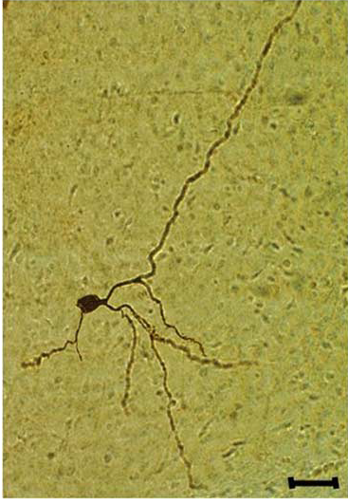
Methods¹¹
In vitro
BNST slices from 24-40 day old Sprague-Dawley rats
Whole cell recordings performed
  Potentials were recorded
Slices were washed and visualized

Slide 10
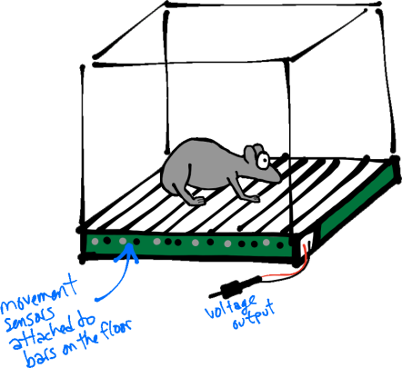
Methods
12 Sprague-Dawley rats
  Housed in groups of 4
6 infused with 5-HT agonist via cannula
  6 infused with vehicle
  Acoustic startle response 1 week later
Acoustic startle response measured
  Acclimated for 80s with bursts
  50 ms white noise
Notes:
-unrestricted access to food

Slide 11
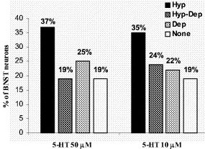
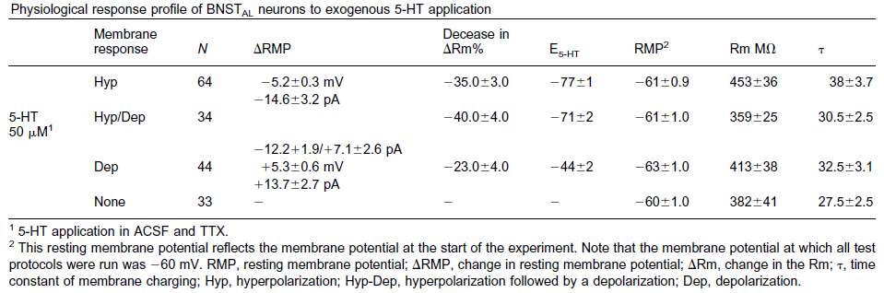
Results
Notes:
-first looked at all neuron reactions to 5-HT application
-heterogeneous response in BNST neurons
-more than 1/3 hyperpolarized→inhibited
-Right Graph: significant hyperpol at 1/5th test dose
-next examined only neurons that became hyperpolarized

Slide 12
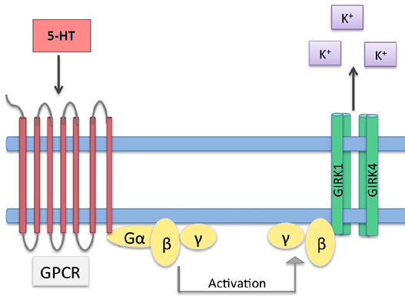
Two groups in hyperpolarized neurons
  75% with GABA-like reversal potential (RP)
  25% with K⁺ -like RP
GIRK-channels linked to hyperpolarization¹¹
  Effects attenuated by GIRK-antagonist
5-HT_{1A} commonly associated with GIRK-channels¹⁰
Notes:
-Two groups in hyp: 75% w/ rev pot like GABA & 25% for K
-theorized hyperpol caused by GABA release from alBNST neurons
-two GABA antagonists failed to change potentials though
-took those 25% of neurons & subjected them to tetrapin-Q
-tetrapin-Q (GIRK-antag) stopped hyperpol→GIRK channels responsible

Slide 13
Acoustic shock test

Slide 14
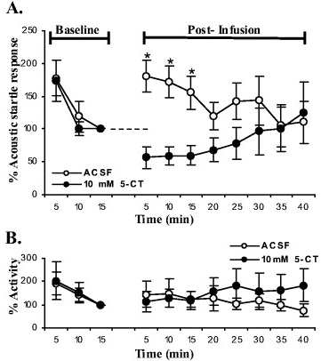
Notes:
-5-CT (10 mM) infused into anteriolateral-BNST→broad spectrum 5-HT1 agonist with strong affinity for 5-HT1A
-First three startles done to get baseline (pre-infusion)
-infusion saw decrease in startle response compared to vehicle (ACSF)
-BNST modulates motor activity & had to make sure that wasn’t decreasing response
-muscle activity was not different in 5-CT infusions throughout tests

Slide 15
Questions
What receptor is responsible for the inhibitory effects of 5-HT in the BNST?
5-HT1_{A} receptors are primarily responsible for BNST inhibition through activation of GIRK-channels (hyperpolarization)
What are the behavioral effects of 5-HT on the BNST during anxiogenic situations?
3. How does 5-HT affect the microcircuitry of the BNST?

Slide 16
Questions
What receptor is primarily responsible for the inhibitory effects of 5-HT in the BNST?
What are the behavioral effects of 5-HT on the BNST in anxiogenic environments?
How does 5-HT affect the microcircuitry of the BNST?

Slide 17
Garcia et al. 2017
Notes:
-Central nucleus of amygdala (CeA) also possibly involved in phasic (short) fear response

Slide 18
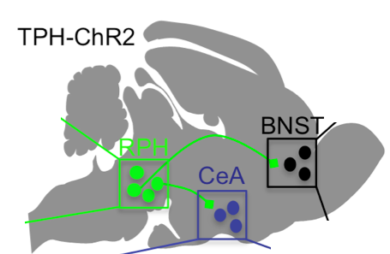
Methods¹²
Two groups of C57 mice
  TPH-ChR2 (+/-)
  Pet-Arch
Behavioral tests
  Open-field
  Elevated-plus maze
  Suppressed feeding
Notes:
-Pet-arch mice were from male 129S-Gt
-Optogenetic stim of TPH-ChR2 triggers 5-HT release
-stim of Pet-Arch inhibits 5-HT release
-in behavioral tests ChR2 mice had a more lit anxiogenic environment (250-300(
-Pet Arch were only mildly anxiogenic (50-60 lx)

Slide 19
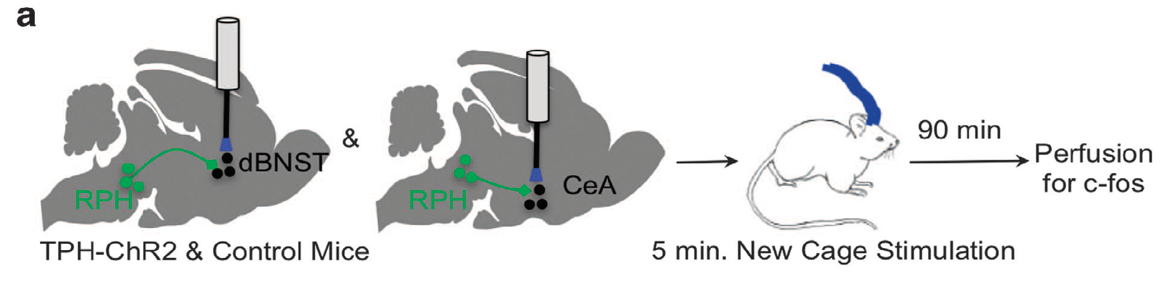
Notes:
-first wanted to see if anxiety (from new cage) was mediated by 5-HT
-exposure to bright areas increases cfos in BNST & Cea (cite #29)
-photostimulated the 5-HT inputs to the dBNST & CeA in new cage

Slide 20
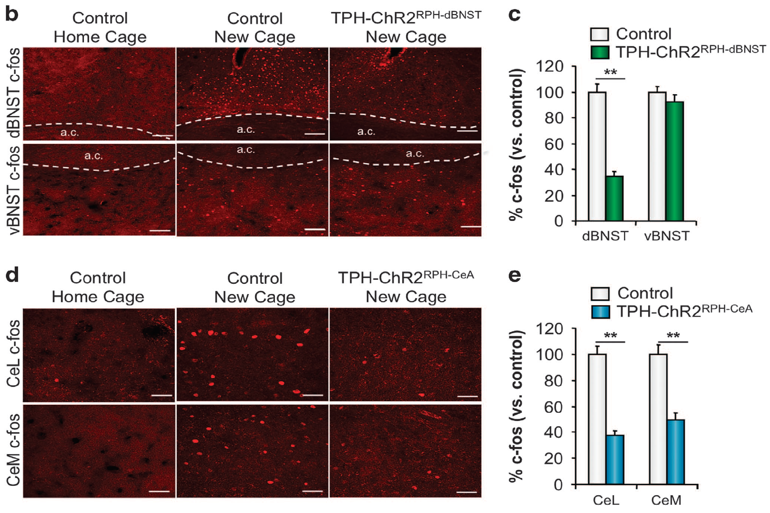
Photostimulation of 5-HT terminals in the dBNST and CeA decreases new cage induced c-fos.
Notes:
-stim of TPH-dBNST mice had less cfos in new cage→decrease anxiogenic response
-stim of CeA also caused decrease in cfos
-focused more on dBNST for most of experiment

Slide 21


Open Field Test
Outer Field
Center
Notes:
-Outer field→ anxious/anxiogenic
-Center→ relaxed/anxyiolytic

Slide 22
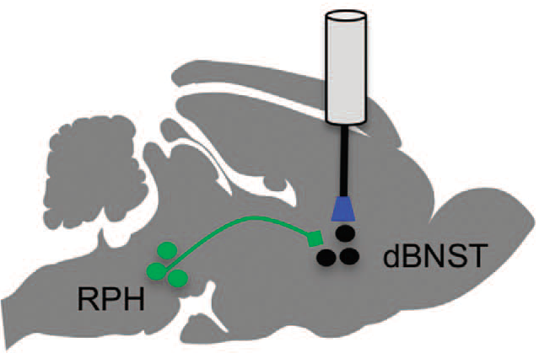
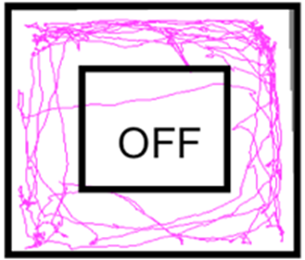

Activation of 5-HT inputs into the dBNST results in anxiolysis.
Notes:
-open field test
-animals were placed in the corner of brightly lit box
-time in center considered “relaxed” state→ normally stick to walls in bright areas
-ChR2 mice→3 3-minute phases (laser stimulation off/on/off)
-Pet-Arch→ 6 1-minutes phases (off/on/off/on/off/on)

Slide 23
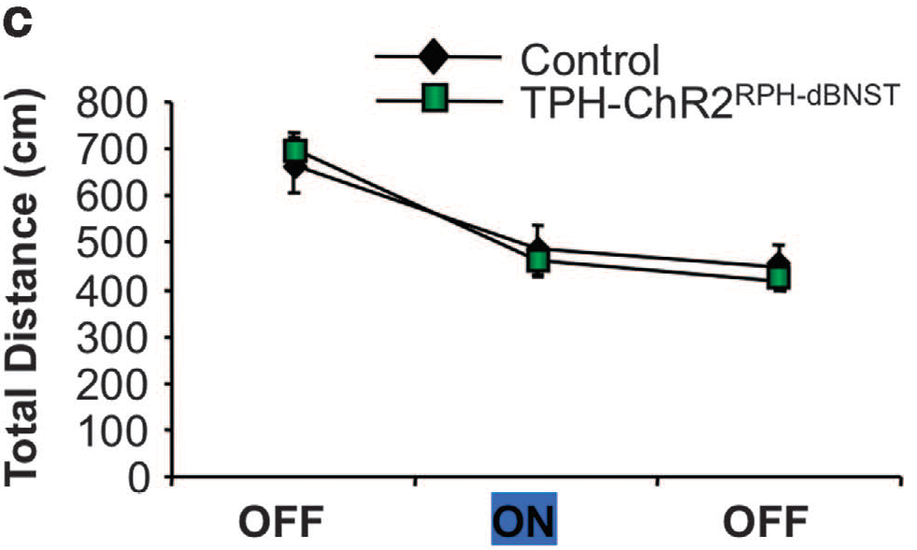
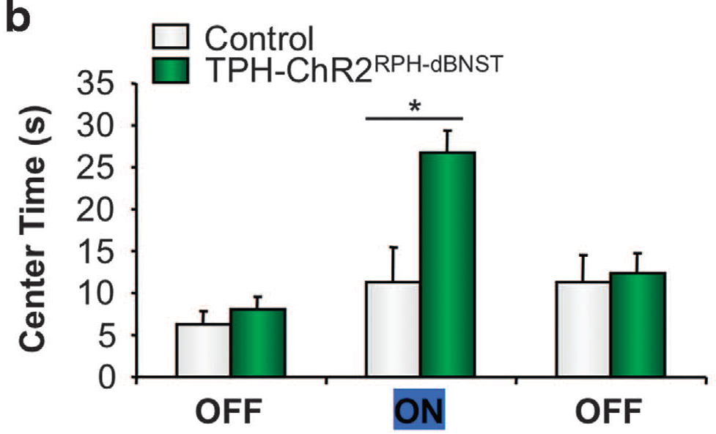
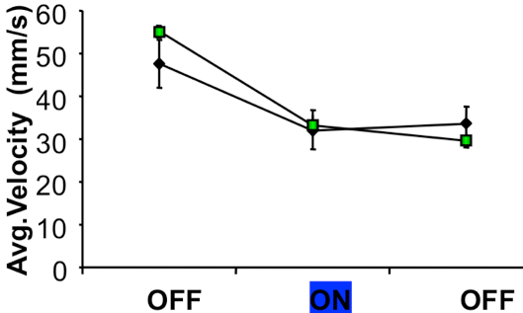
Activation of 5-HT inputs into the BNST results in anxiolysis
Open Field Test
Notes:
B) 5-HT resulted in more time spent in the center during “on” phase→less anxious
- suggests 5-ht to dBNST related to anxiolysis
C) No change in total distance travelled→no effect on motor skills (like paper #1)
-no change in velocity either→cnfrms anxiolysis not from 5-ht motor problems

Slide 24
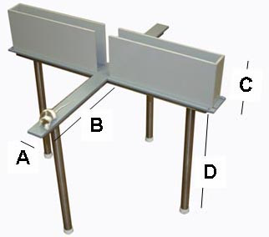
Elevated Plus Maze

Slide 25
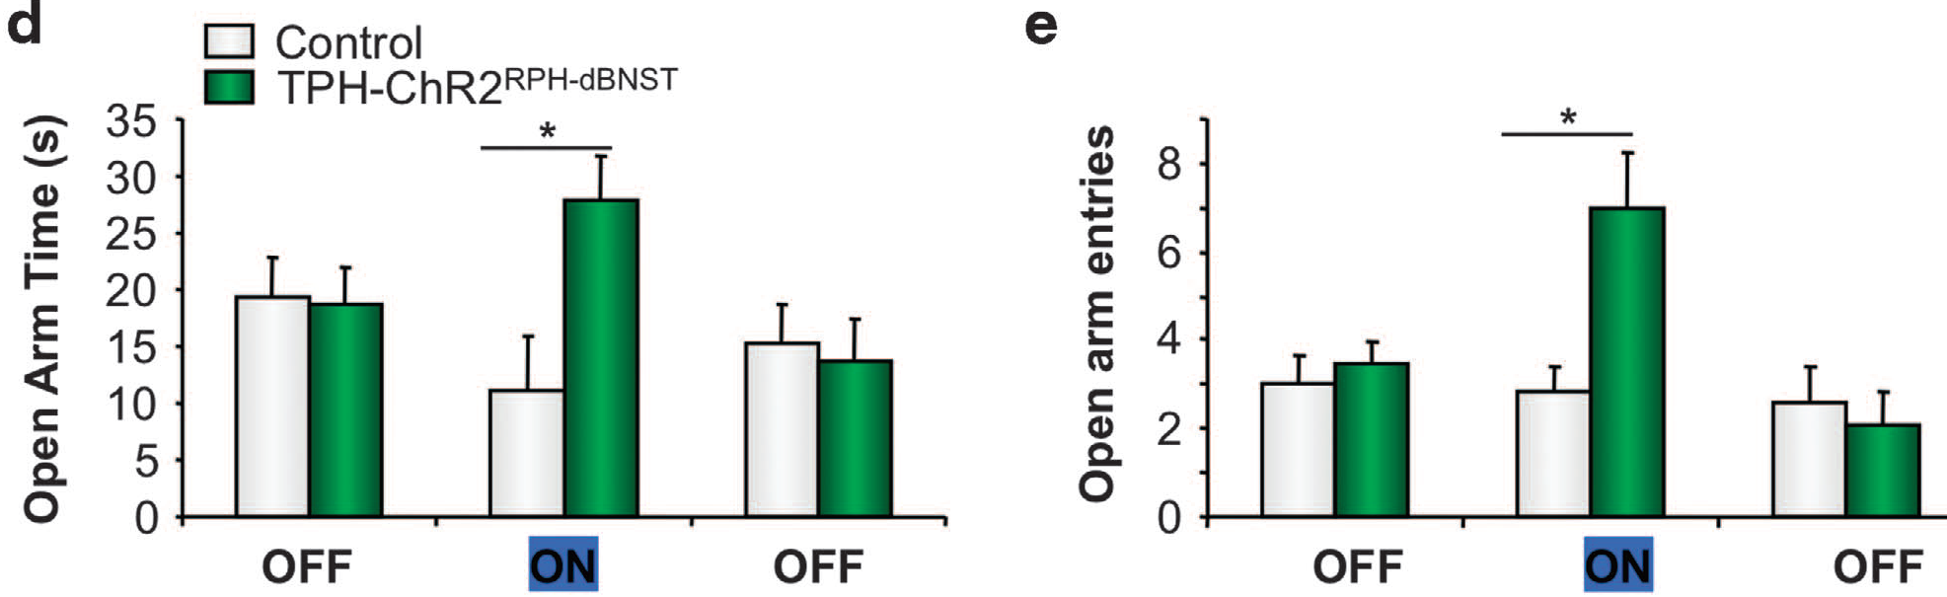
Activation of 5-HT inputs into the dBNST results in anxiolysis.
Elevated Plus Maze
Notes:
d) 5-ht inputs caused mouse to spend more time in open arms→anxiolytic
e)5-ht showed more open arm entries→confirms anxiolytic quality

Slide 26
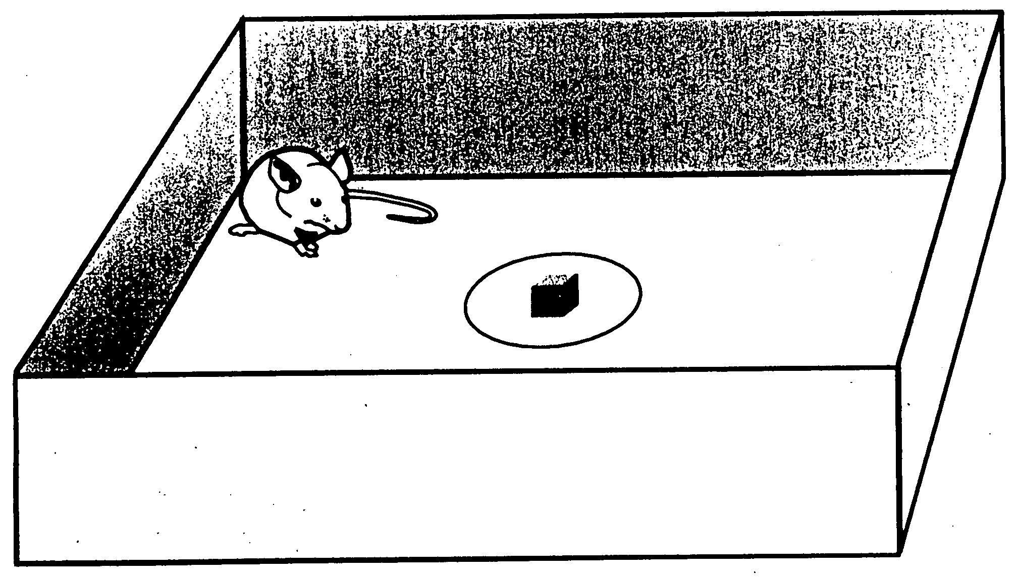
Novelty-Suppressed Feeding Test
Notes:
-measures a rodent’s aversion/anxiety towards eating in a new (novel) environment

Slide 27
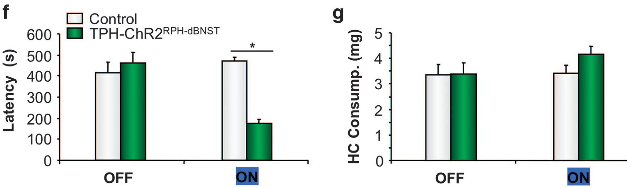
Activation of 5-HT inputs into the dBNST results in anxiolysis.
Novelty-Suppressed Feeding
Notes:
-novel feeding test
Food restricted 24h prior→placed in brightly lit box with food in middle (time until eaten or 600 seconds)
-time between eating was decreased→anxiolytic
-distance was same→motor skills not reason for anxiolysis

Slide 28
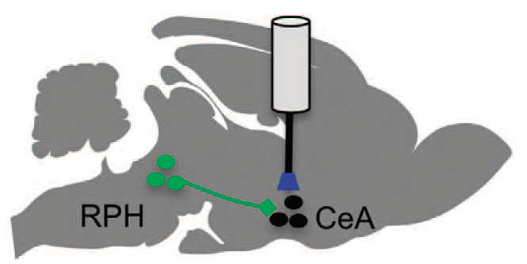
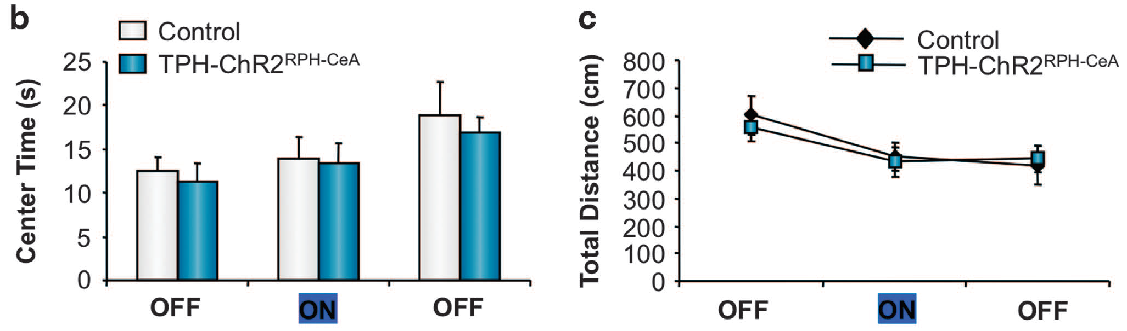
Activation of 5-HT terminals in the CeA has no effect on anxiety.
Open Field Test
Notes:
-Central nucleus of the amygdala (CeA) also strongly linked to phasic fear responses
-also innervated by RPH 5-HT
A)CeA 5-ht activation caused no change in open field test
C) 5-ht did not change distance

Slide 29
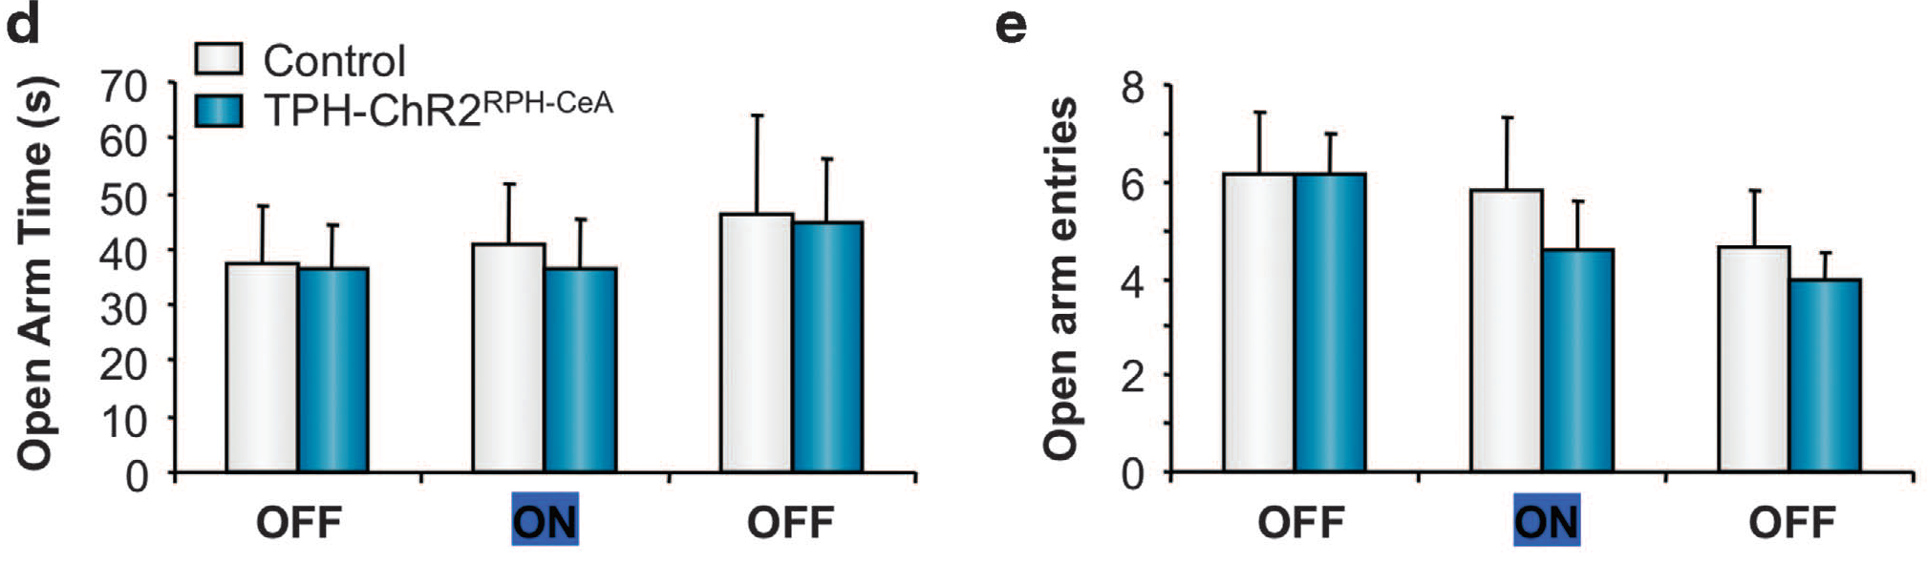
Activation of 5-HT terminals in the CeA has no effect on anxiety.
Elevated Plus Maze
Notes:
-no change in open arm test from 5-ht on CeA
-no changes seen in motor distance & velocity too→ same as dBNST

Slide 30
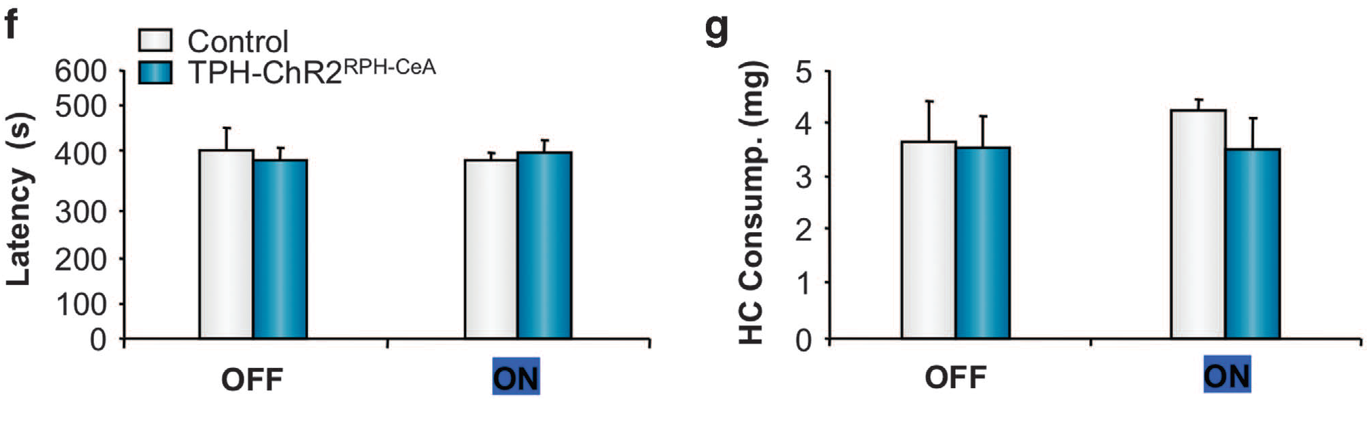
Activation of 5-HT terminals in the CeA has no effect on anxiety.
Novelty-Suppressed Feeding
Notes:
-no change in novel feeding test→all point to CeA regulation of anxiety not 5-ht modulated

Slide 31
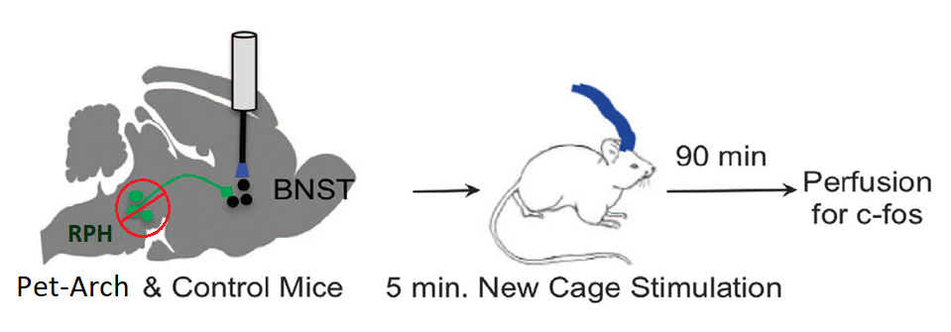
Notes:
-next wanted to examine inhibition of RPH mediated 5-ht release
-Pet-Arch→inhibits 5-HT release onto BNST from RPH

Slide 32
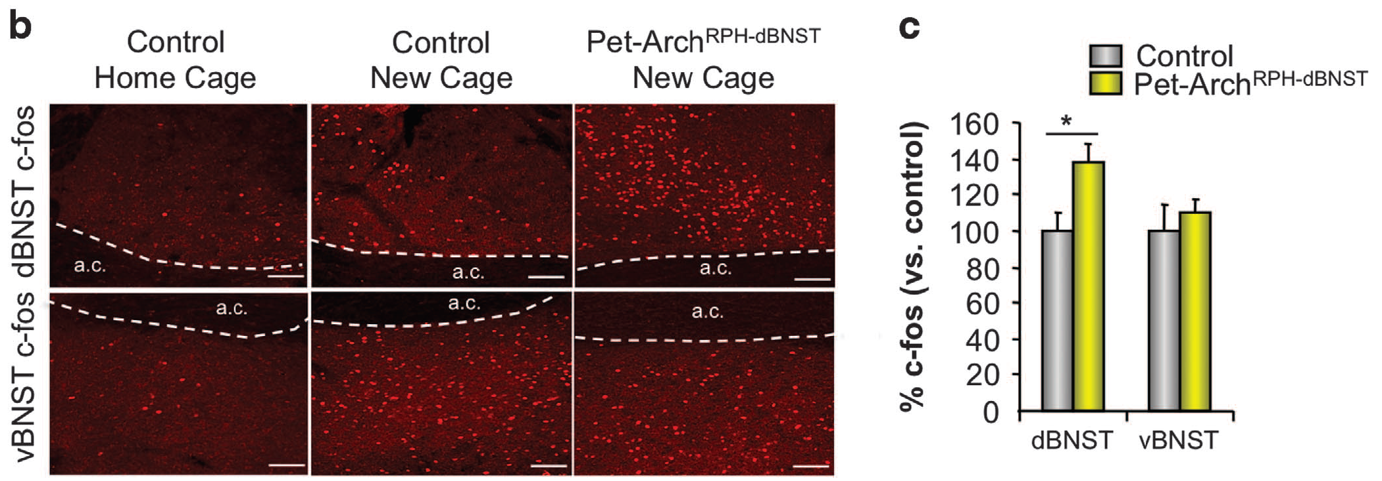
Inhibition of 5-HT inputs in the dBNST increases anxiety-like behaviors.
Notes:
-next wanted to examine inhibition of RPH mediated 5-ht release
-used Pet-Arch (Archaerhodopsin)→outflux of protons→hyperpolarization
A) more c-fos in inhibition of 5-ht in dBNST→ more anxiogenic response
-no significant change in vBNST

Slide 33
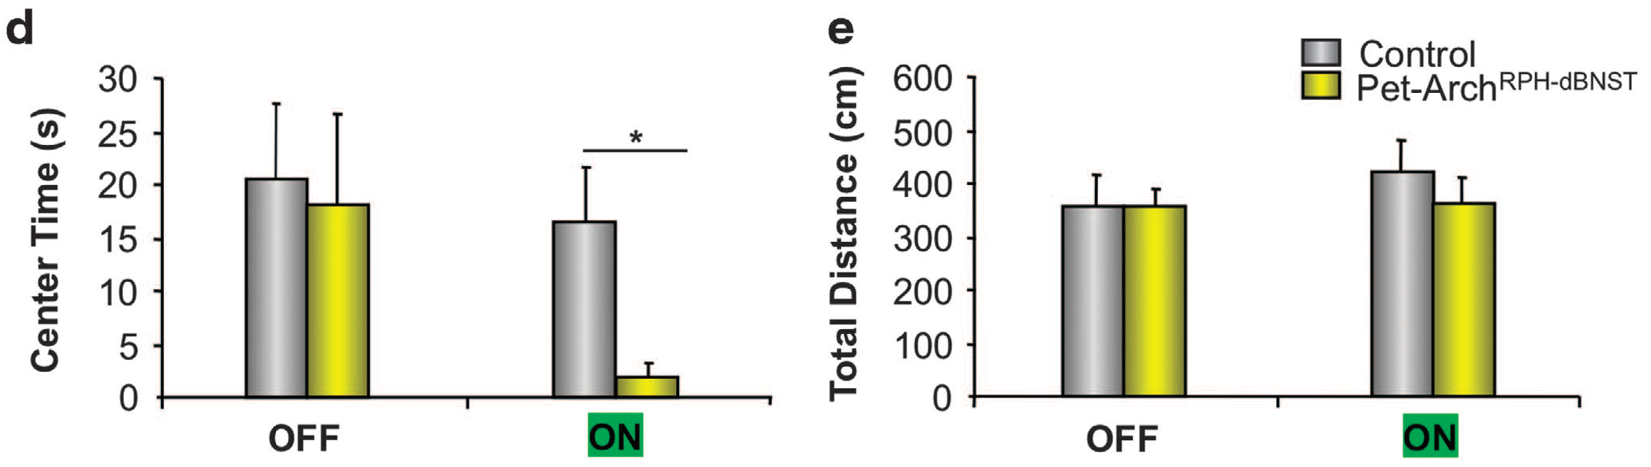
Inhibition of 5-HT inputs in the dBNST increases anxiety-like behaviors.
Open Field Test
Notes:
-next did the open field test
D)Pet-Arch mice spent significantly less time in middle during ON phase (photostimulation)
E) No significant change in total distance traveled

Slide 34
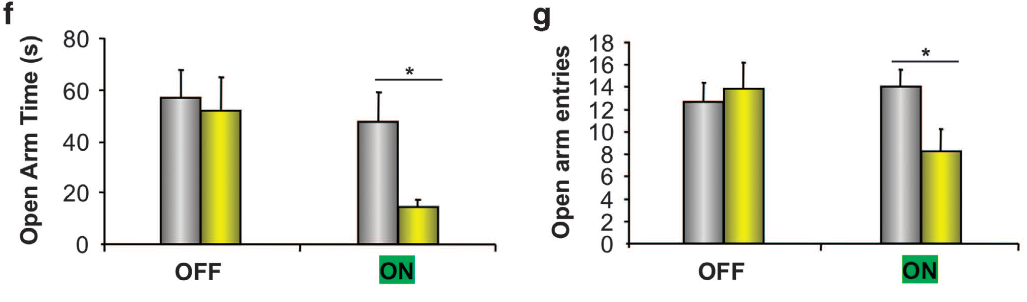

Inhibition of 5-HT inputs in the dBNST increases anxiety-like behaviors.
Elevated Plus Maze
Notes:
-next did open arm experiment
F)Pet-Arch spent significantly less time in open arms→increased anxiogenic response
G)More open arm entries
-→all point to inhibition of 5-ht to dBNST leads to more anxiogenic response

Slide 35
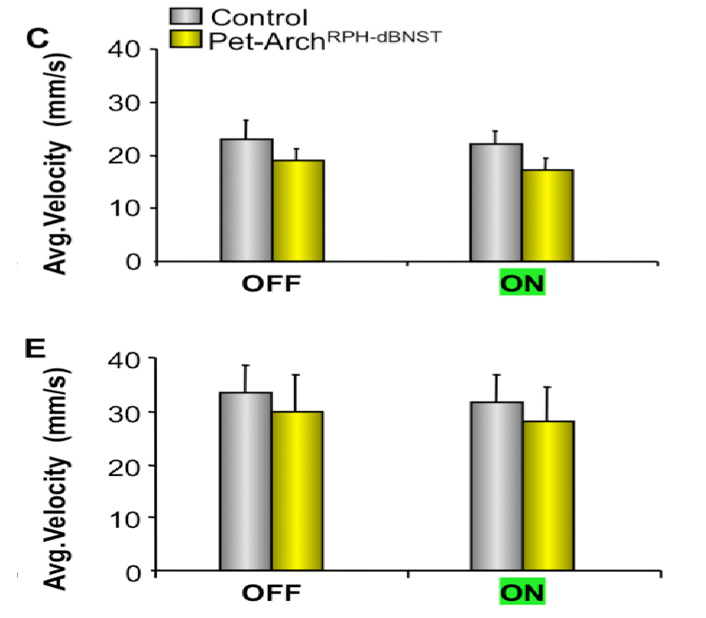
Notes:
C)Open field test
E) Open arms test
-inhibition had no effect on motor skills
-anxiogenic response not from motor response

Slide 36
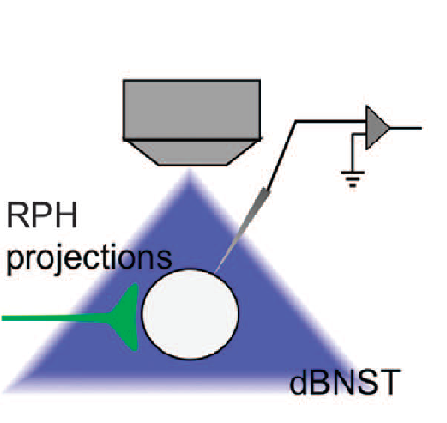
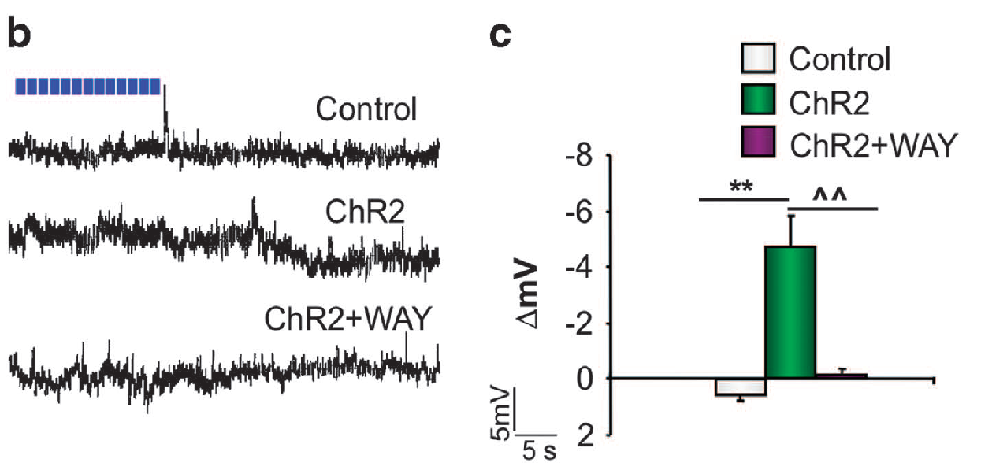
The behavioral effects of 5-HT release in the dBNST are mediated by the activation of 5-HT1A receptors.
Notes:
-next wanted to determine what was causing this decrease in anxiety in dBNST
-previous studies have linked 5-HT1A to anxiolysis (paper #1)
-performed whole cell patch clamp on 6-8 week old Ch2 mice
-B) delayed (45s after stim) hyperpolarizing response in ChR2 mice
-WAY100635 (5-ht1a antaonist) prevent hyperpol→5-ht1a recept responsible
C) Quantification of hyperpol magnititude→confirms B

Slide 37
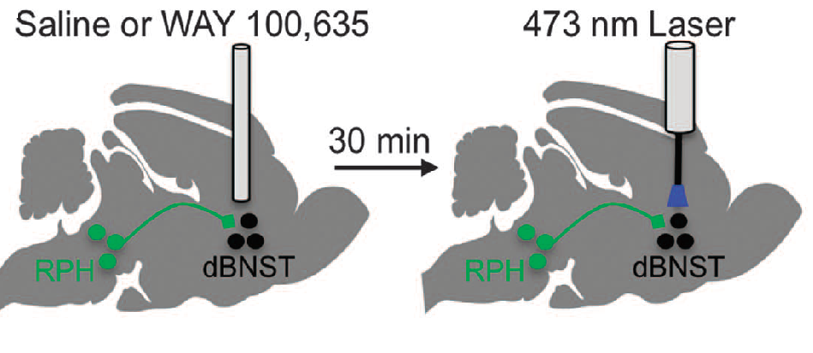
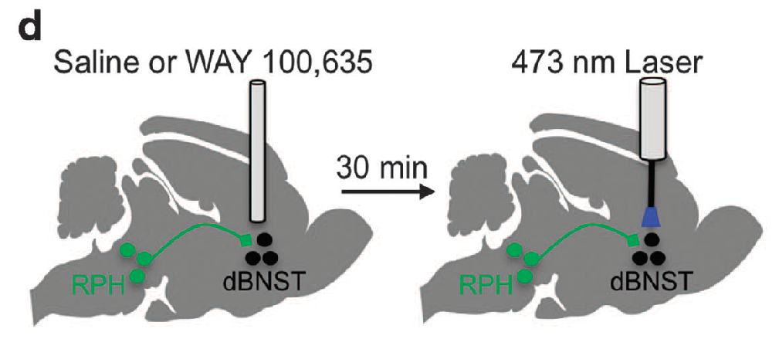
The behavioral effects of 5-HT release in the dbnst are mediated by the activation of 5-HT1A receptors.
Notes:
-next wanted to examine the behavioral effects of 5-ht1A antag (WAY)
-fiber optic attached to 8 mice who received WAY or a saline vehicle (all CHR2)
-3 main behavioral tests ran
1. open field
2. elevated plus maze
3. novel suppressed feeding

Slide 38
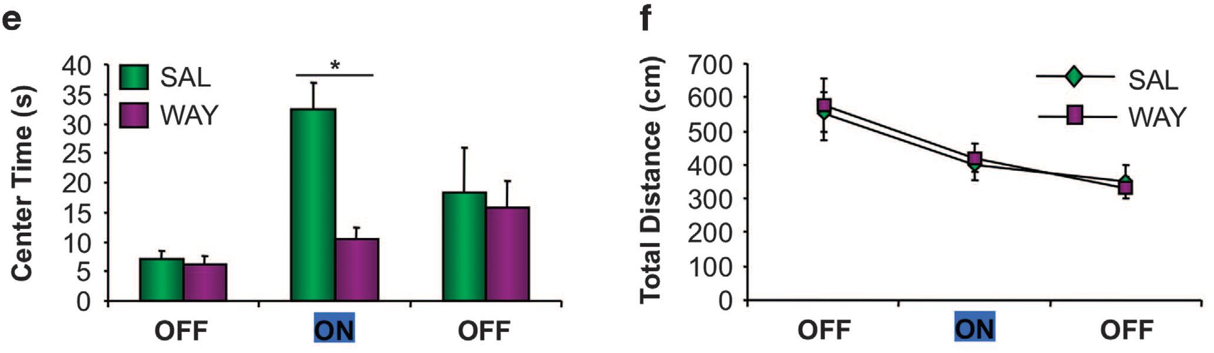
The behavioral effects of 5-HT release in the dbnst are mediated by the activation of 5-HT1A receptors.
Open Field Test
Notes:
Open field test
E) Anxiety induced behavior seen in ON phase inhibited by WAY
F) Total distance unchanged
→points to 5-ht1a being the receptor behind anxiolytic activity

Slide 39
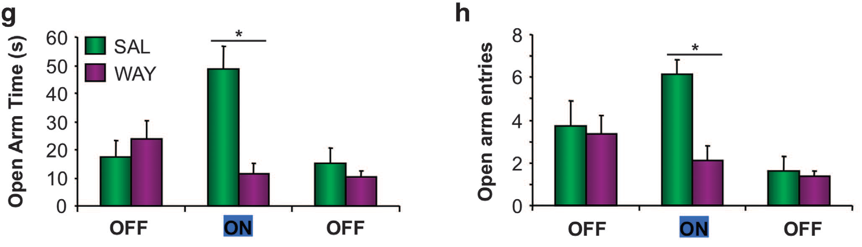
The behavioral effects of 5-HT release in the dbnst are mediated by the activation of 5-HT1A receptors.
Elevated Plus Maze
Notes:
Open Arm Test
G) Anxiety inhibition from 5-ht1a prevented by WAY
F) Same effect as seen on G
→confirms 5-ht1a as anxiolytic receptor involved in response to anxiety

Slide 40
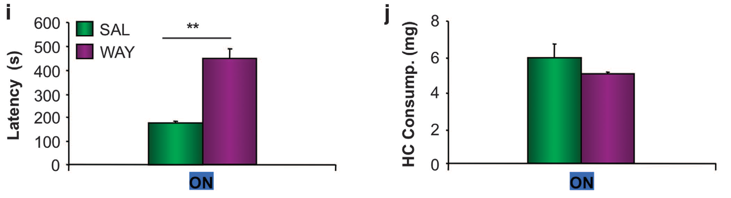
The behavioral effects of 5-HT release in the dbnst are mediated by the activation of 5-HT1A receptors.
Novelty-Suppressed Feeding
Notes:
Time spent waiting to eat pellet increased by WAY→ inhibition of 5-hta1 suppresses anxiolysis
J) No change in amount eaten
Confirm previous two tests about 5-ht1a effect on anxiolysis
All point to 5-ht1a on dBNST as mediator of anxiety response and NOT 5-ht1a on CeA

Slide 41
Questions
What receptor is primarily responsible for the inhibitory effects of 5-HT in the BNST?
What are the behavioral effects of 5-HT on the BNST in anxiogenic environments?
5-HT release in the dBNST, but not the CeA, attenuates anxiogenesis in a 5-HT_{1A}-dependent manner (under natural conditions)
3. How does 5-HT affect the microcircuitry of the BNST?

Slide 42
Questions
What receptor is primarily responsible for the inhibitory effects of 5-HT in the BNST?
What are the behavioral effects of 5-HT on the BNST in anxiogenic environments?
How does 5-HT affect the microcircuitry of the BNST?

Slide 43
MARCINKIEWCZ ET AL. 2016

Slide 44

Methods¹³
C57 mice used
Fluorogold (FG) used to retrotrace fibers
ChR2-eYFP used to visualize BNST
DREADD (hM4D & hM3D)
Behavioral tests
  Elevated Plus Maze
  Cued Fear Test
Notes:
-8-16 week old mice used
-Used optogenetics like Paper #2
-also in vitro (whole cell clamp) & in vivo (optogenetics)
-Yellow Fluorescent Protein (YFP)
-Dorsal Raphe Nucleus (DRN)
-SERT→ serotonin transporter promoter sequence→cause 5-ht release
-Designer Receptors Exclusively Activated by Designer Drugs (M4D=Gi-coupled: M3D=Gq-coupled)

Slide 45
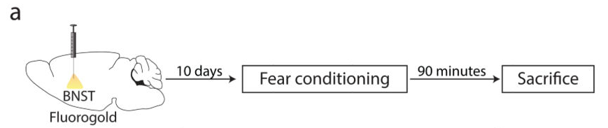
Notes:
-first wanted to make sure 5-ht induction in BNST occurred following stress
-performed aversive footshock fear conditioning and examined DRN activity in 13 mice
-Conditioning protocol: -given five 30s tones paired with randomly intense 2s shock with spaces of 60-120s between (randomly assigned)
-13 mice

Slide 46
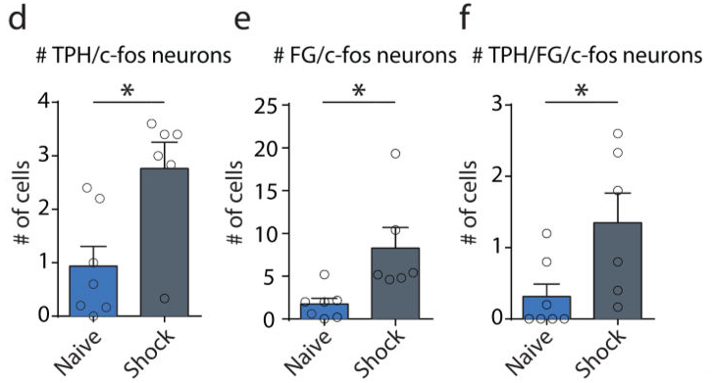
Optogenetic identification of a ^{5-HT}DRN→BNST projection that elicits anxiety and fear-related behavior.
Notes:
-examined serotogenic activity of DR-neurons
-FG used to retrotrace neurons
-no change in # of neurons projecting DRN→BNST following shock
-D-F) footshock led to significant increase in 5-ht DRN→BNST activity

Slide 47

Notes:
Sidenote: this paper found that releasing 5-ht in all of BNST is anxiogenic
-Paper #2 found that 5-ht to dBNST is anxiolytic
-Paper # 1 also found 5-ht to be anxiolytic in all BNST and specifically alBNST
Why could this be? (according to paper #2)
-differences in methodology
-#2 used 3-5mW laser &#3 used 10mW with different laser positioning→ likely activated the dBNST & vBNST→much more 5-ht release
-anxiogenic conditions were different→#2 had 250-300lx & #3 used 14lx→ less anxiogenic conditions may have not engaged the BNST significantly

Slide 48
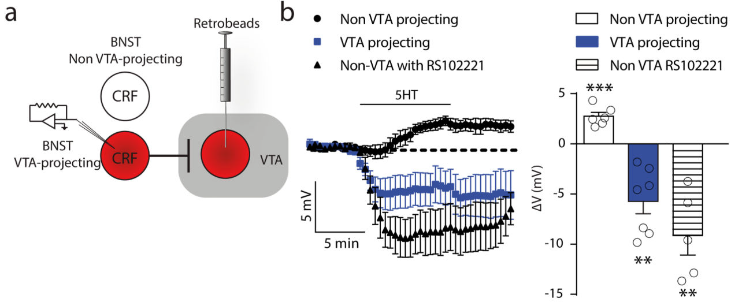
Serotonin activates a local population of CRF^{BNST} neurons that inhibits outputs to the midbrain.
Notes:
-also examined effect of 5-ht on CRF release
-looked at 5-ht2C→previous research shown 5-HT2C KO became anxiolytic & had reduced expression in CRF-BNST neurons (#9 on 3rd paper)
-hypothesized distinct CRF neurons in the BNST that are differentially sensitive to 5-ht
B) non-VTA projecting became depolarized; excitation reversed by 5-ht2c antagonist (RS1)→different subsets of CRF-BNST

Slide 49
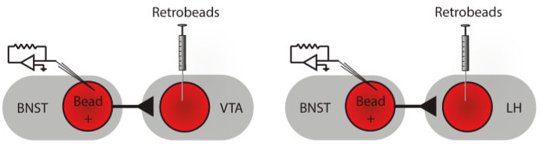
Serotonin activates a local population of ^{CRF}BNST neurons that inhibits outputs to the midbrain.
Notes:
-previous studies have shown CRF-BNST neurons are exclusively GABAergic→IPSP (13)
→neurons going from BNST->VTA reported to be anxiolytic (19)
-hypothesized that non-VTA projecting neurons locally inhibit these neurons→anxiogenic
*stimulated CRF-BNST neurons and saw AP’s in CRF neurons & IPSP’s in VTA neurons -->CRF-BNSt neurons are GABAergic**

Slide 50
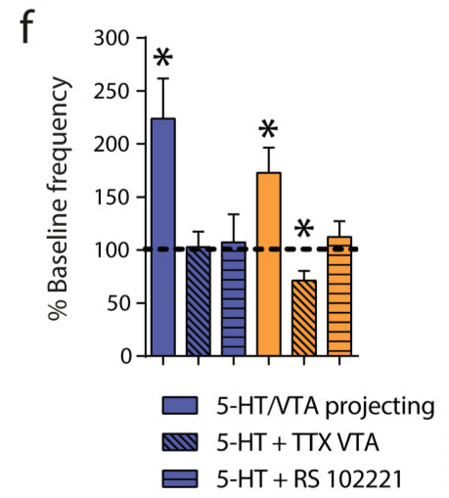
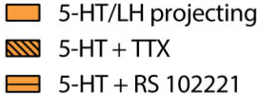
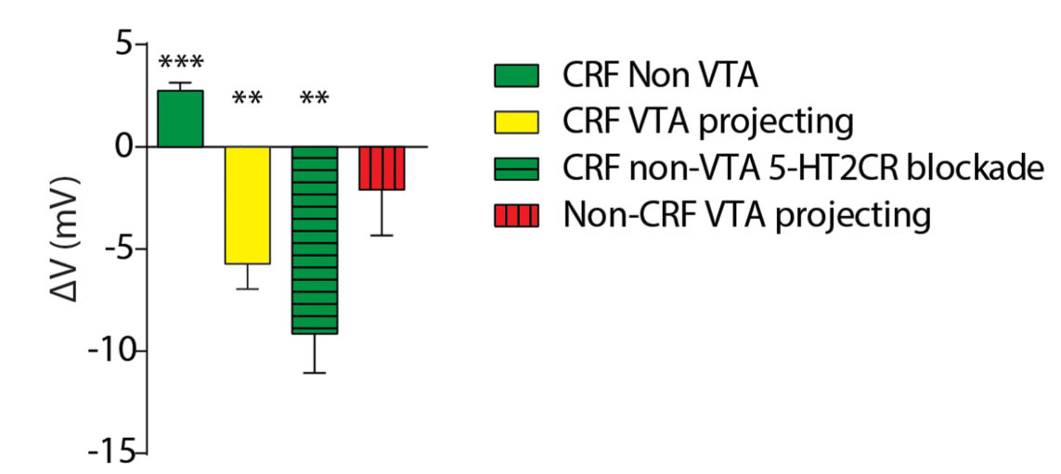

Serotonin activates a local population of ^{CRF}BNST neurons that inhibits outputs to the midbrain.
Notes:
E)Same as Fig 2B→shows non-CRF VTA projections are NOT excited by 5-HT
F)5-ht increased IPSP frequency on VTA-projecting BNST neuron→ being hyperpol’d by LNs→5-ht responsible for inhibition of vta projections
G)5-htc2 antagonist stopped IPSP’s→ activation depends on 5-htc2 receptor

Slide 51
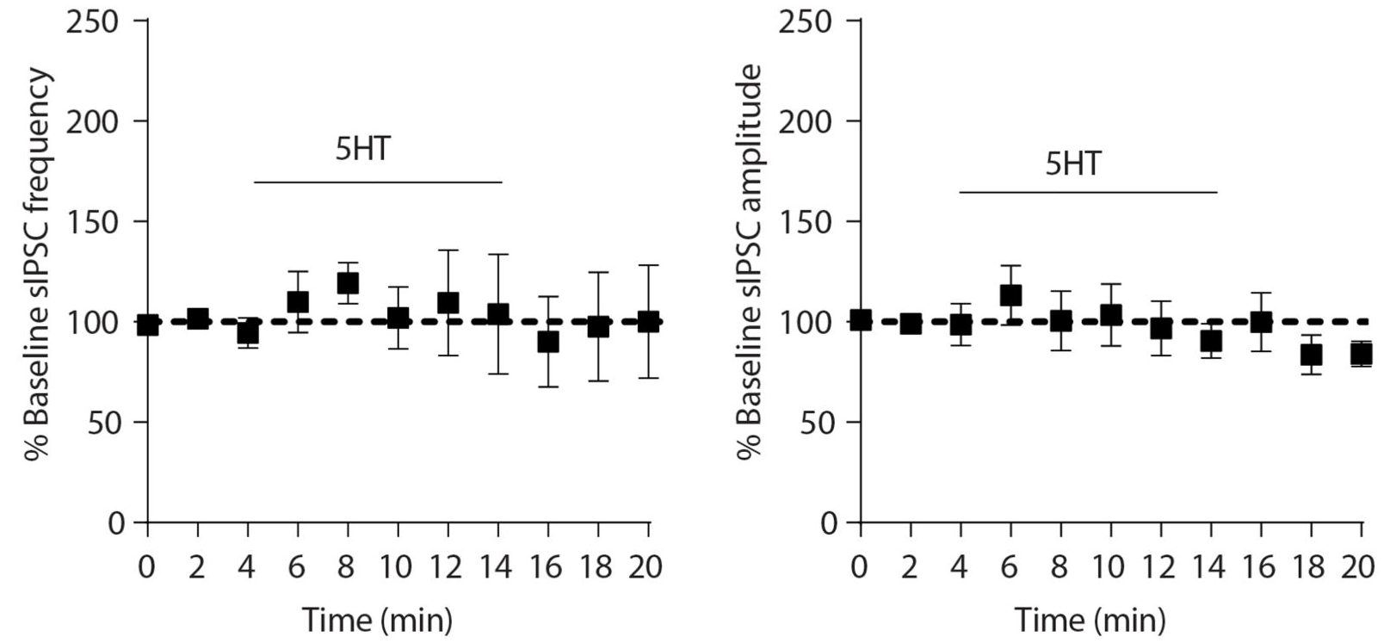
5-HT does not alter GABAergic transmission in CRF neurons
Notes:
-wanted to make sure 5-ht was not affecting other CRF neurons
-All CRF neurons (from 3 mice) subjected to 5-HT bath
-saw no change in IPSP’s in CRF population→not from artifact

Slide 52
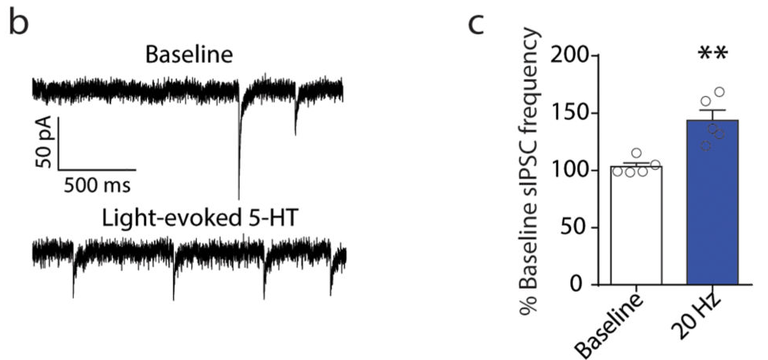
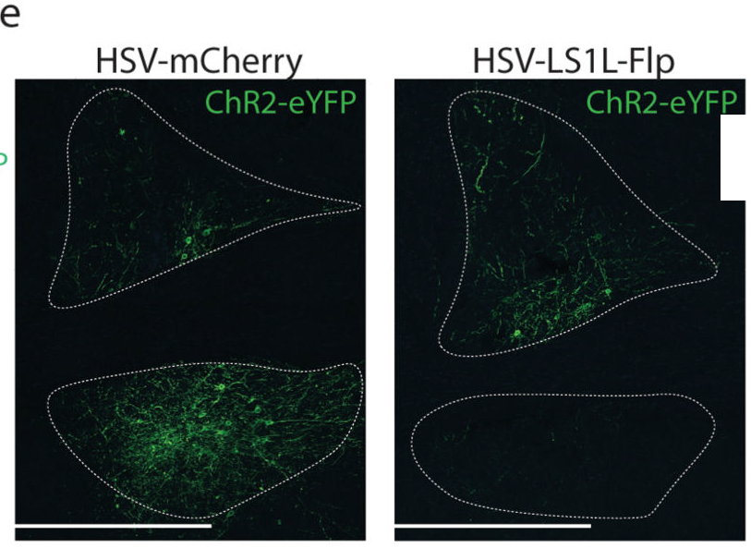
Optogenetic and Intersectional characterization of 5-HT-CRF circuits in the BNST and outputs to the midbrain
D
V
Notes:
-next wanted to examine if optically evoked 5-ht stimulation could inhibit BNST
→all previous experiments were using bath applied 5-ht
B/C) ISPC’s increased on VTA-projecting neurons
Dorsal: top portion of BNST (mCherry is control)
Ventral: bottom portion
D) Activation also inhibited PN’s in vBNST→most VTA & LH PN’s come from vBNST

Slide 53
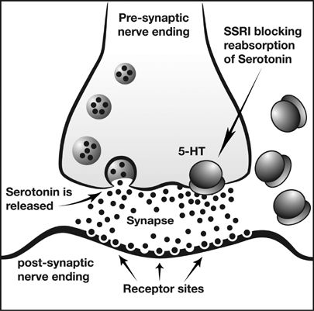
SSRIs
Notes:
-next wanted to examine how BNST microcircuits are affected by SSRI’s (which increase 5-HT levels)
-previous research had shown the BNST to be involved in the negative side effects of SSRi in mice (4)

Slide 54

Acute fluoxetine elicits aversive behavior by engaging inhibitory CRF circuits in the BNST.
Notes:
-injected fluoxetine (Prozac→common SSRI) & examined IPSC’s

Slide 55

Acute fluoxetine elicits aversive behavior by engaging inhibitory CRF circuits in the BNST.
Notes:
C/D) acute injection of fluoxetine increased IPSP frequency on VTA-projecting neurons→inhibition of BNST-VTA outputs

Slide 56

Acute fluoxetine elicits aversive behavior by engaging inhibitory CRF circuits in the BNST.
Elevated Plus Maze
Notes:
-wanted to examine effect of fluoxetine on CRF LNs in behavioral tests
-used DREADD (hM4D) to silence CRF-BNST LNs
G) Elevated Maze→ SSRI increased anxiety but was attenuated by DREAAD inhibition of CRF-LNs
*even w/o FLUOX silencing of CRF LNs was anxiolytic**

Slide 57


Acute fluoxetine elicits aversive behavior by engaging inhibitory CRF circuits in the BNST.
Notes:
-next looked at SSRI effect on fear-related behavior
-CNO→used to activated DREADD receptors
-Silenced CRF-BNST LN w/ Gi-couped receptor (hM4D)
-5 fear conditioning shocks paired w/tone
-J) Inhibition of CRF-BNST LN did not affect fear learning
-K) hM4D attenuated FLUOX-induced enhanced fear recall

Slide 58

Acute fluoxetine elicits aversive behavior by engaging inhibitory CRF circuits in the BNST.
Notes:
-Next looked at DREADD (+) of CRF-BNST PNs & effect on FLUOX-induced anxiety
1st graph) CRF-BNST PN (+) did not impact fear acquisition
2nd graph) CRF-BNST PN (+) attenuated FLUOX-induced fear recall
-→all these point toward acute SSRI treatment enhancing aversive behaviors thru CRF-BNST LN recruitment that inhibit VTA/LH PNs

Slide 59
Questions
What receptor is primarily responsible for the inhibitory effects of 5-HT in the BNST?
What are the behavioral effects of 5-HT on the BNST in anxiogenic environments?
How can 5-HT affect the microcircuitry of the BNST?
Acute 5-HT release inhibits anxiolytic BNST-VTA/LH projections through the activation of local ^{CRF}BNST neurons (in a 5-HT_{2C} dependent manner), resulting in anxiogenesis

Slide 60
Conclusion
The inhibitory, hyperpolarizing response of BNST neurons to 5-HT is primarily caused by 5-HT_{1A} activation of GIRK-channels
5-HT release in the dBNST, but not the CeA, attenuates anxiogenesis under natural conditions in a 5-HT_{1A}-dependent manner
Acute 5-HT release can inhibit the anxiolytic responses of the BNST by recruiting local ^{CRF}BNST neurons in a 5-HT_{2C}-dependent manner
Notes:
3. Acute 5-ht release can affect microcircuits in an anxiogenic manner→why SSRIs might increase anxiety initially

Slide 61
References
Ludwig C et al. (1868). Das Verhalten der Gase, welche mit dem Blut durch den reizbaren Säugethiermuskel strömen. Arbeiten aus der physiologischen Anstalt zu Leipzig 3:1-61
Manfred Gothert. (2013). Serotonin discovery and stepwise disclosure of 5-HT receptor complexity over four decades. Part I. General background and discovery of serotonin as a basis for 5-HT receptor identification . Pharm Reports 65:771-86
Berger M et al. (2009). The expanded biology of serotonin. Annual Review of Medicine. 60:355-66
Hannon J et al. (2008). Molecular biology of 5-HT receptors. Behav Brain Res 16:198-213
Yohn C et al. (2017). The role of 5-HT receptors in depression. Molec Brain 10:28
Hayes DJ et al. (2011). 5-HT receptors and reward-related behavior: a review. Neuro Bio Rev 6:1419-49
Hornung JP. (2003). The human raphe nuclei and the serotnergic system. J Chem Neuroanat 4:331-43
McDevitt RA et al. (2011). Regulation of dorsalraphe nucleus function by serotonin autoreceptors: a behavioral perspective, J Chem Neurosci 4:234-46
Avery SN et al. (2015). The human BNST: functional role in anxiety and addiction. Neurospycpharm 41:126-41
Guo JD et al. (2009). Bi-directional modulation of BNST neurons by 5-HT: Molecular expression and functional properties of excitatory 5-HT receptor subtypes/ Neurosci 164:1776-1793
Hazra R et al. (2012). Differential distribution of serotonin receptor subtypes in BNST(ALG) neurons: modulation by unpredictable shock stress. Neurosci 6:9-21
Levita L et al. (2004). 5-HT1A-like receptor activation in the BNST: Electrophysiological and behavioral studies. Neurosci 128:83-96
Garcia Al et al. (2017). Serotonin inputs to the dBNST modulate anxiety in a 5-HT1A receptor-dependent manner. Molec Psy 00:1-8
Marcinkiewcz CA et al. (2016). Serotonin engages an anxiety and fear-promoting circuit in the extended amygdala. Nature 537:97-101

